Slide 1
Matlab

Slide 2
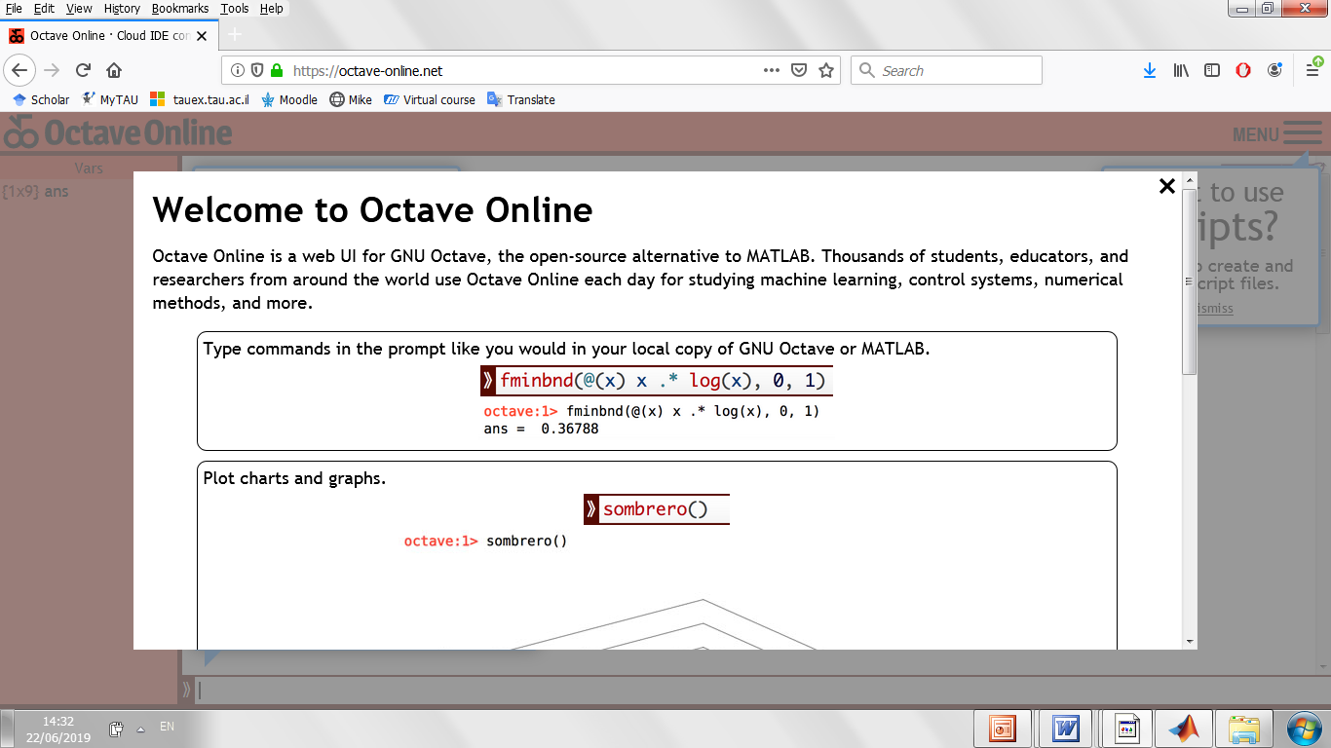

Slide 3
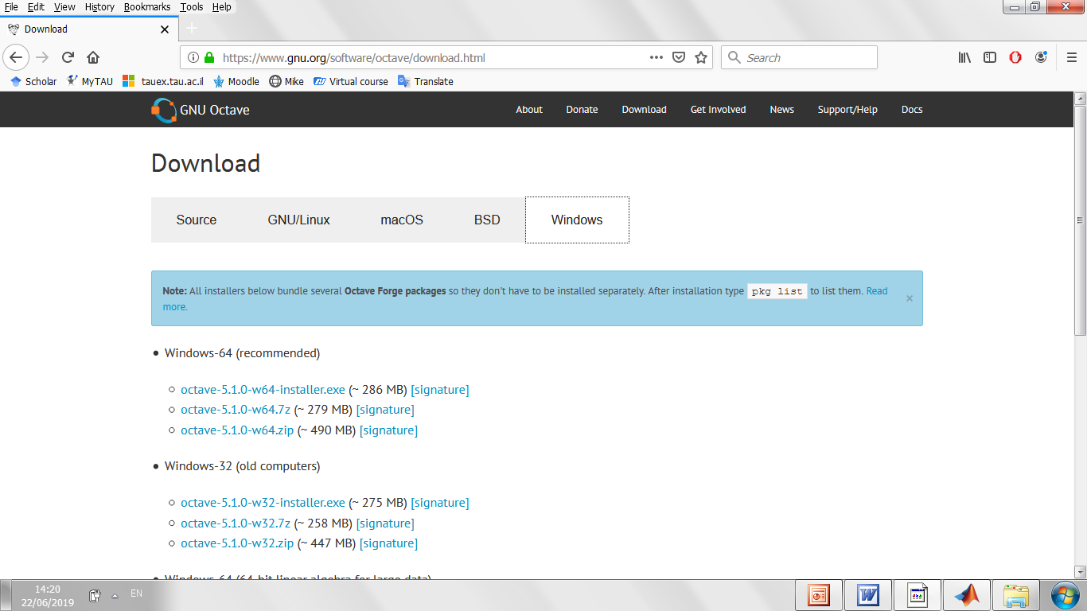

Slide 4
Vector a list of numbers arranged in a row or a column

Slide 5
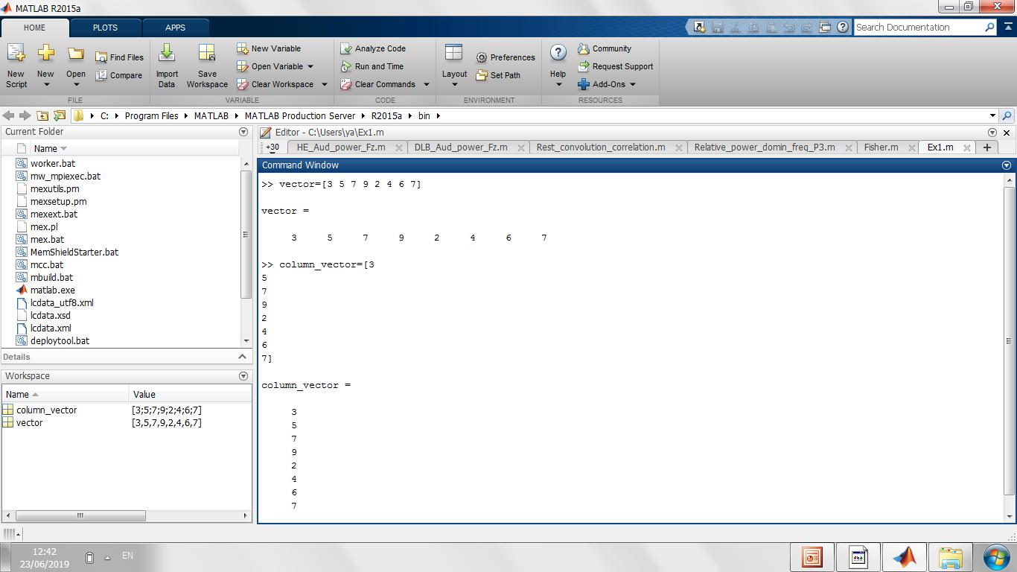
Vector

Slide 6
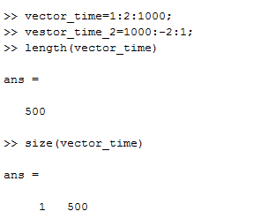
Vector

Slide 7
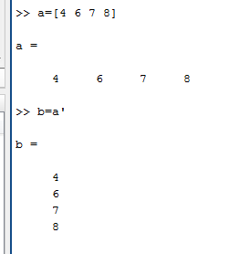
Transpose operator

Slide 8
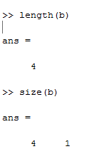
size

Slide 9
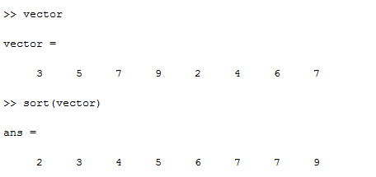
sort
B = sort(A,'descend’)

Slide 10
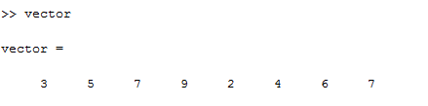
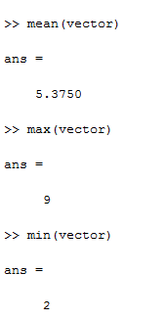
mean min max

Slide 11
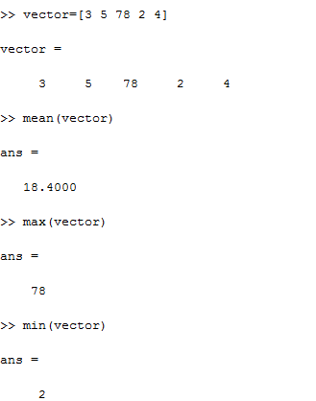

Slide 12
Now do exercise 1

Slide 13
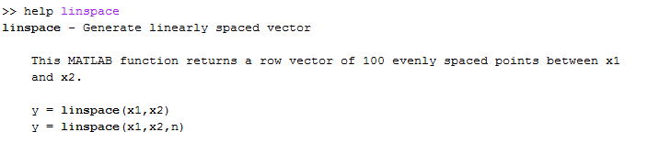
linspace

Slide 14
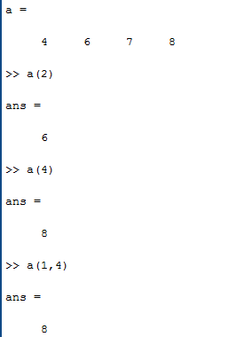
Vector addressing
individually

Slide 15
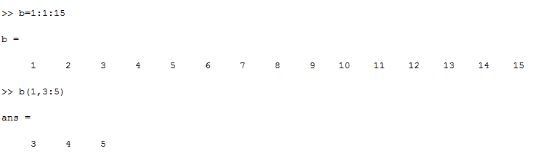
In subgroups

Slide 16
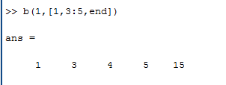

Slide 17
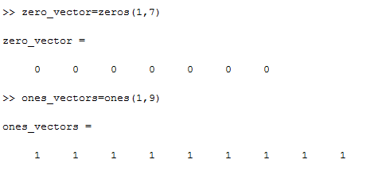
zeros and ones commands

Slide 18
Now do exercise 2

Slide 19
String an array of characters

Slide 20
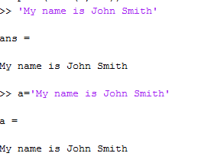
Strings

Slide 21
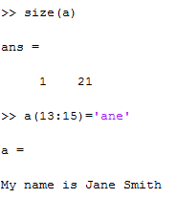
Strings

Slide 22
Now do exercise 3

Slide 23
Summary
min
max
mean
sort
linspace
length
size
‘
end

Slide 24
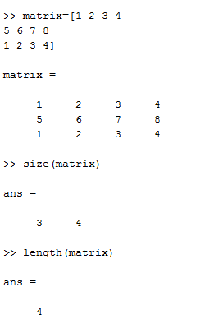
Matrix

Slide 25
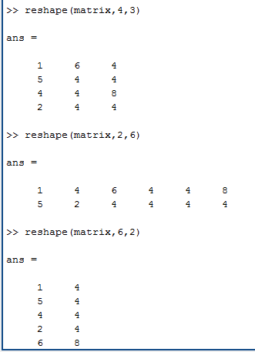
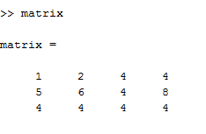
reshape

Slide 26
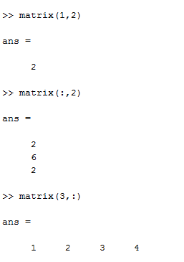
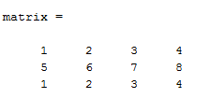
Matrix addressing

Slide 27
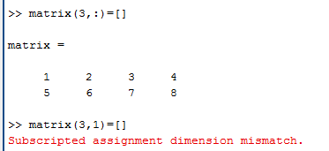
Deleting elements

Slide 28
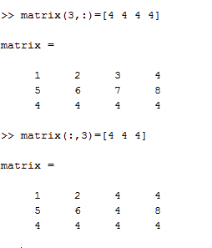
Adding elements

Slide 29
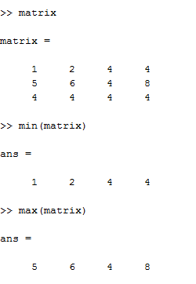
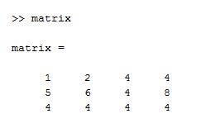
mean min max

Slide 30
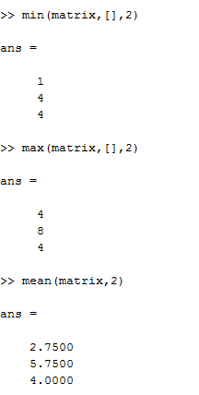
mean min max by second dimension

Slide 31
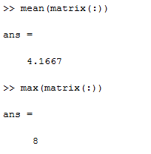
General mean min max

Slide 32
Now do exercise 4

Slide 33
1. The time vector is
Time_vector=1:2:1000;
How much time the signal was measured in milliseconds? ______________
What was the sample rate of the device? ______________________
2. Define time vector when you measure the signal
A) during 1 sec with sample rate 1000
B) during 2000 milliseconds with sample rate 200
C) during one quarter of a minute with sample rate 100
B) during 1500 milliseconds with sample rate 500
3. What is the length of time_vector? length(time_vector)
4. Write the formula which calculates the length of step in time vector using time vector

Slide 34
1. The time vector is
Time_vector=1:2:1000;
How much time the signal was measured in milliseconds? _________1000
What was the sample rate of the device? ______________________1000/2=500
2. Define time vector when you measure the signal
A) during 1 sec with sample rate 1000 1:1:1000
B) during 2000 milliseconds with sample rate 200 1:5:2000
C) during one quarter of a minute with sample rate 100 1:10:15000
B) during 1500 milliseconds with sample rate 500 1:2:1500
3. What is the length of time_vector? length(time_vector)
4. Write the formula which calculates the length of step in time vector using time vector
Step=1000/sample_rate;

Slide 35
Script
time_vector=1:step:time_length
length_of_time_vector=length(time_vector)
time_vector=1:step:time_length
length_of_time_vector=length(time_vector)

Slide 36
Now do exercise 5

